Slide 1
Support of the GITEWS Project
Consulting and Software Development for the German Indonesian Tsunami Early Warning System (GITEWS)
  Contracting party: DLR, Germany
  Project studies for implementing a Sensor Data Center and interoperable decision support components by using the 52°North WPS Framework
  Implementation of components for Sensor Data Center which provides data for the control center

Slide 2
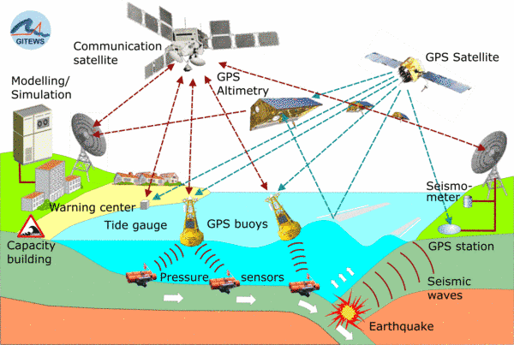
Support of the GITEWS Project
Source: GITEWS Consortium

